Slide 1
A1 Chemistry
History of the Atom

Slide 2
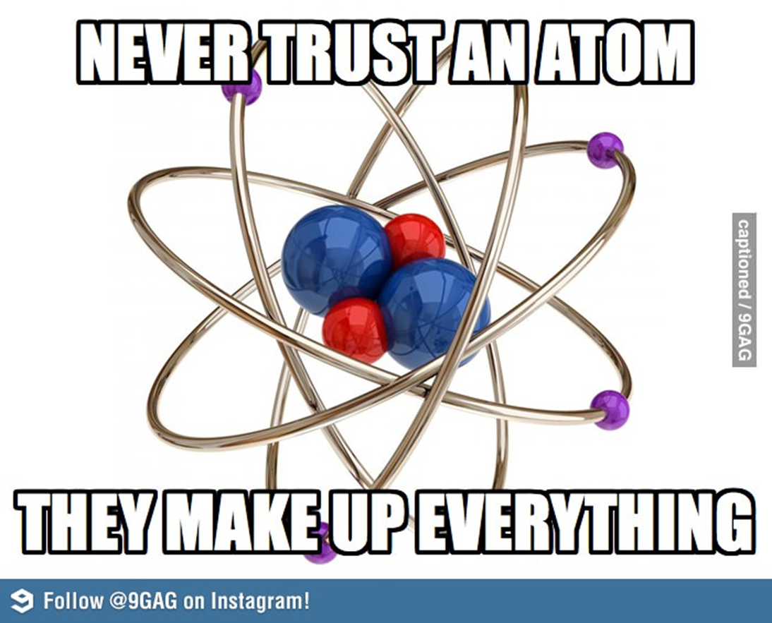

Slide 3
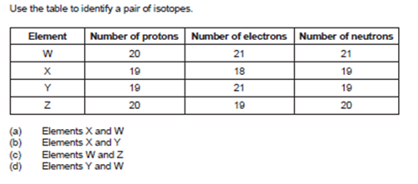

Slide 4
Learning Intention
findings from a range of scientific experiments contributed to the understanding of the atom, enabling scientists, including Dalton, Thomson, Rutherford, Bohr and Chadwick to develop models of atomic structure and make reliable predictions about the mass, charge and location of the sub-atomic particles.

Slide 5
Success criteria
Name the model associated with Dalton, Thomson, Rutherford, Bohr and Chadwick
Label representations of each model
Describe and explain each model, including significant particles or quantities that were discovered
Describe experiments or equipment that were used in developing each model

Slide 6
Key words
indivisible
Plum Pudding model
Nuclear Model
Planetary model
emission spectra
excited electrons
bombardment
Quantum Mechanical Model
orbitals

Slide 7
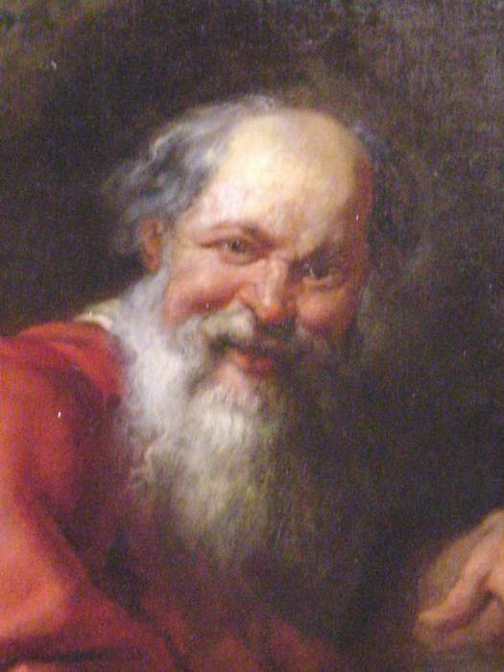
Modern Atomic Theory: A brief history
400 BC, Greek philosopher Democritus proposed that matter is made up of small, hard, indivisible particles, which he called atoms.

Slide 8
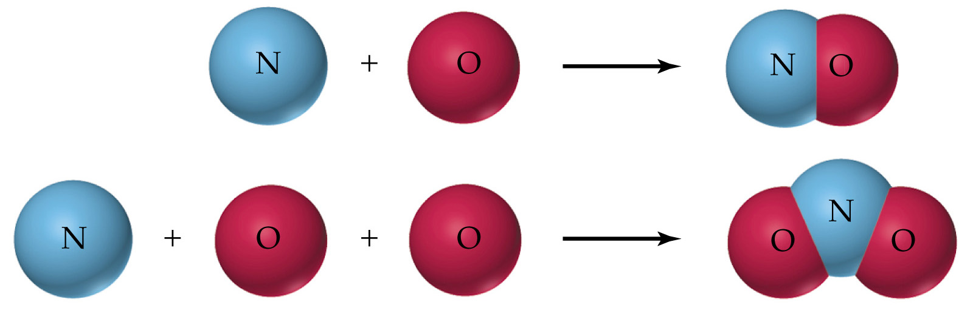
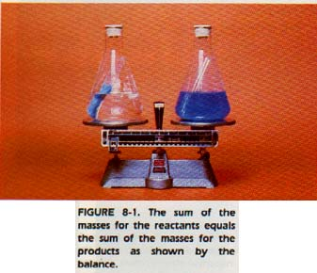
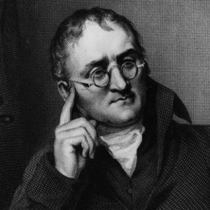
1803-1808 John Dalton
“Billiard Ball Model”
Matter is composed of tiny indivisible particles called atoms.
(Law of Conservation of Mass, Lavoisier, 1789)
All atoms of the one element are identical but different to atoms of other elements.
(Law of Constant Composition, Proust, 1799)
Chemical reactions consist of rearranging atoms in simple whole number ratios.
(Law of Multiple Proportions, Dalton)

Slide 9
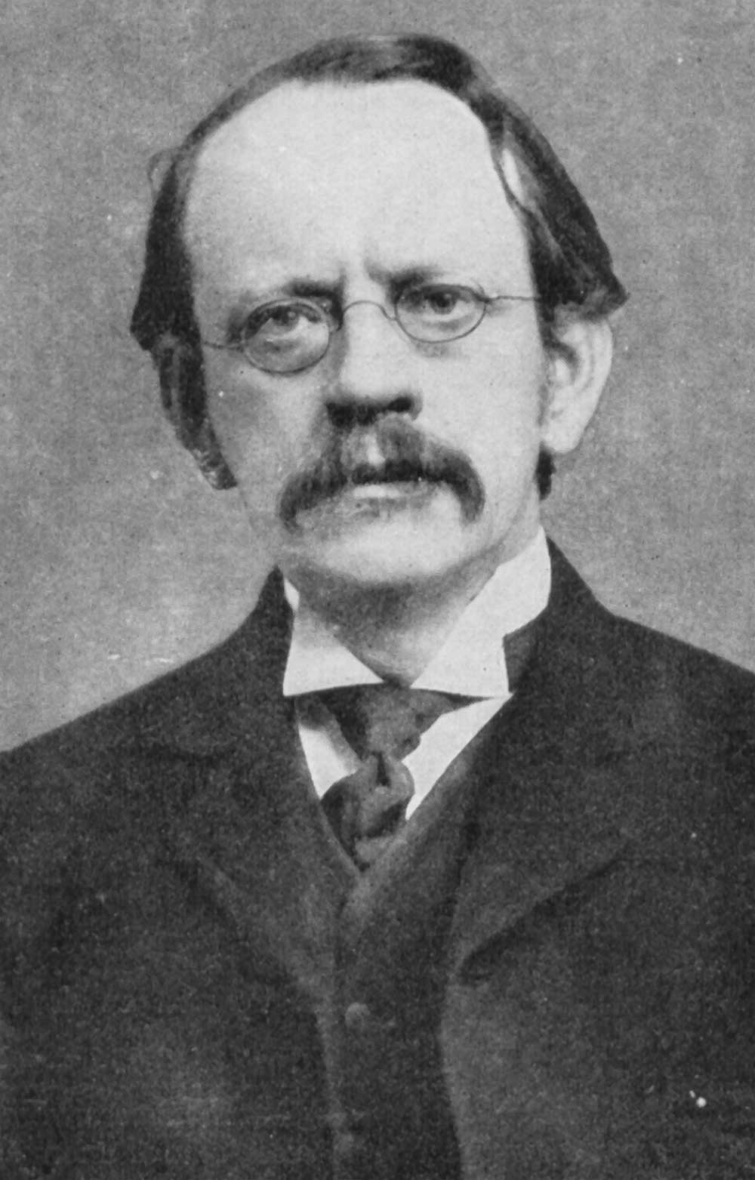
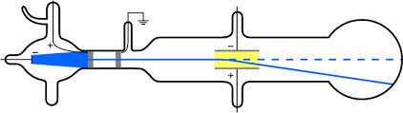
1904 Joseph J. Thomson
“Plum Pudding Model” of the divisible atom
Atoms consist of a large sphere of uniform positive charge embedded with negatively charged particles.
The total positive charge of the sphere equals the total negative charge of the sphere
Cathode ray (Crookes) tube showed that canal rays (positive) were different when passed through different gases, but cathode rays (negative) were identical regardless of electrodes or gas used.

Slide 10
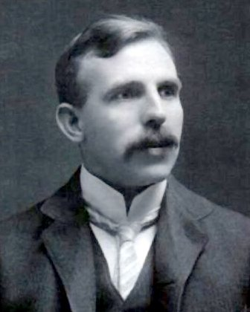
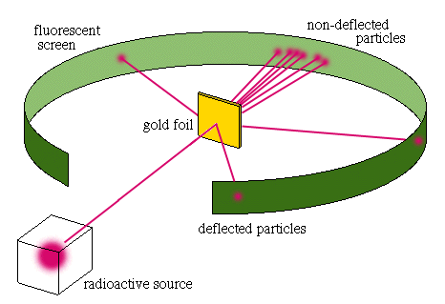
1911 Ernest Rutherford
“Nuclear Model”
A very small positively charged nucleus contains most of the mass of the atom.
A very large volume around the nucleus in which electrons move.
The number of protons equals the number of electrons.
Gold foil experiment

Slide 11
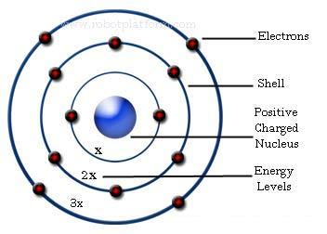
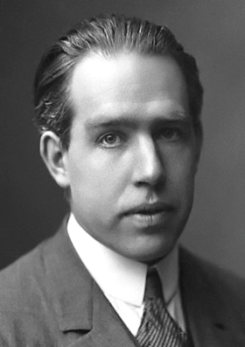
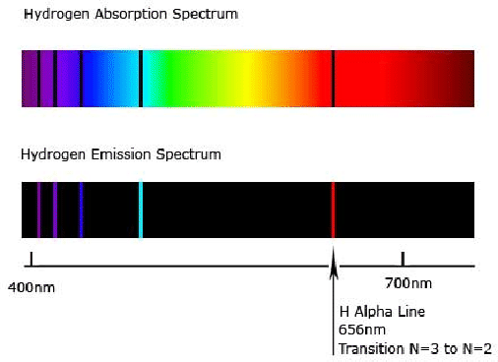
1913 Niels Bohr
“Planetary Model”
Electrons move around the nucleus in fixed orbits. An electron in a particular orbit has constant energy.
An electron can absorb energy and move to a higher energy orbit.
An excited electron can fall back to its original orbit, emitting energy as radiation.
Emission spectra of hydrogen

Slide 12
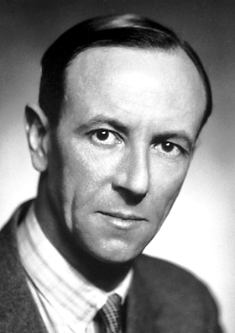
1932 James Chadwick
The nucleus of an atom contains neutrons, electrically neutral particles with a mass similar to that of a proton.
Bombarded beryllium with alpha particles and discovered Rutherford’s missing mass; explained the existence of isotopes ( Mass Spectroscope was invented in 1920)

Slide 13
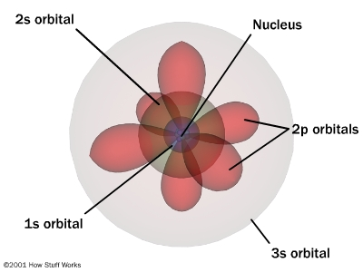
Current: Quantum Mechanical Model
Electrons occupy orbitals, volumes of space in which there is a high probability of finding an electron.
Energy levels are made up of sublevels.
Each sublevel contains a set of orbitals.
Orbitals contain up to 2 electrons only.

Slide 14
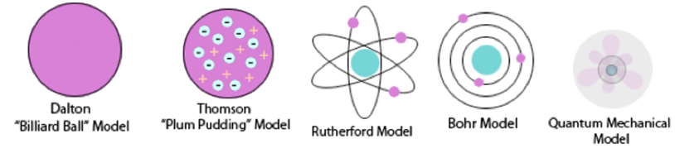

Slide 15
Success criteria
Name the model associated with Dalton, Thomson, Rutherford, Bohr and Chadwick
Label representations of each model
Describe and explain each model, including significant particles or quantities that were discovered
Describe experiments or equipment that were used in developing each model

